Slide 1
Introduction to Decision Modeling
Decision Modeling in R Workshop
August 2021

Slide 2
Introduction to Decision Analysis
Notes:
Part 1 = Showing code 3 state model
Part 2 = Exercise build Sick-Sicker model
Part 3 = Show answers of Sick-Sicker

Slide 3
What is Decision Analysis?
Explicit, quantitative and systematic approach to decision making under uncertainty
Identify, measure, and value the consequences of different decision alternatives as well as the uncertainty that exists when the decision needs to be made
Help structure the analysts’ thinking and facilitate the communication of assumptions
Elements are incorporated into a mathematical model which is used to estimate the outcomes of different options or interventions

Slide 4


Decision Analysis
Option 1
Option 2
Option 3
Harms?
Benefits?
Cost?

Slide 5
Prevalence
of disease
Health-related
quality of life
Efficacy of treatment
Risks of treatment
Decision
model
Risk of future events
Adherence
Costs
Test characteristics
Health & economic
outcomes for
alternative strategies
Policy
Implications

Slide 6
Model Types
Decision trees
Schematic representation of uncertain events/consequences of different alternatives
Cohort state transition models
Dynamic model that captures disease progression and other events
Simulates a homogeneous cohort
Usually deterministic
Individual-based models / microsimulation
Stochastic dynamic model
Simulates individuals
Most flexible model type

Slide 7
Analysis Outcomes
Notes:
Part 1 = Showing code 3 state model
Part 2 = Exercise build Sick-Sicker model
Part 3 = Show answers of Sick-Sicker

Slide 8
Health Outcomes
Disease-specific
Intermediate clinical markers
Cases averted
Events averted
Generic
Lives saved / deaths averted
Life-years gained
Quality-adjusted life-years (QALYs) gained

Slide 9
Quality-Adjusted Life-Years
1.0
0.9
0.7
0.3
0
2
3.5
4.5
7
Time
(years)
← Life span →
QALYs =
(2)(1)
+(1.5)(.7)
+(1)(.3)
+(2.5)(.9)
= 5.6

Slide 10
Costs
Formal healthcare sector
Facilities and resources
Drugs and devices
Personnel time
Informal healthcare sector
Patient time
Unpaid caregiver time
Transportation costs
Non-healthcare sector
Legal or criminal justice
Education
Housing

Slide 11
Cost-Effectiveness Analysis
Subset of decision analytic questions where the objective is to balance costs and health benefits
Defined willingness-to-pay per unit of health benefit (also called cost-effectiveness threshold)
40,000
C
30,000
Cost ($)
$50,000/QALY
20,000
B
10,000
A
$20,000/QALY
0
8
8.5
9
Effectiveness (QALYs)

Slide 12
Strengths and Challenges of Decision Modeling
Notes:
Part 1 = Showing code 3 state model
Part 2 = Exercise build Sick-Sicker model
Part 3 = Show answers of Sick-Sicker

Slide 13
Strengths of Modeling
Clarifies decision-making
Can use data from different sources
Allows explicit and systematic characterization of uncertainty
Extrapolates short-term observations into long-term outcomes
Can translate intermediate endpoints into life-years or QALYs gained
Encourages “what if” analyses

Slide 14
Challenges of Modeling
Validation issues
Model may be incorrectly specified (wrong structure)
Data to inform input parameter values may be lacking or of poor quality
Not all decision considerations lend themselves well to modeling
Communication issues
Transparency
Trust

Slide 15
Decision Tree Example
Notes:
Part 1 = Showing code 3 state model
Part 2 = Exercise build Sick-Sicker model
Part 3 = Show answers of Sick-Sicker

Slide 16
Simple Decision Tree
Viral encephalitis can be caused by herpes virus (HVE) or other viruses (OVE); Pr(HVE) = 52%.
Untreated HVE leads to death or severe sequelae in 71%; for OVE the figure is 1%.
A drug, vidarabine, decreases mortality or severe sequelae due to HVE from 71% down to 36%.
Side effects cause an increase in mortality among OVE patients treated with vidarabine from 1% to 20%.

Slide 17
Summarize Model Parameters
Variable | Variable Name | Value
Prevalence of HVE | p_HVE | 0.52
Probability of complications (death or sequelae) without treatment
HVE | p_HVE_comp | 0.71
OVE | p_OVE_comp | 0.01
Probability of complications (death or sequelae) with vidarabine treatment
HVE | p_HVE_comp_tx | 0.36
OVE | p_OVE_comp_tx | 0.20

Slide 18
To treat or not to treat
HVE
0.36
0.52
Treat
0.48
OVE
0.20
HVE
0.71
0.52
Do not treat
0.48
OVE
0.01
Outcome = Pr(mortality or severe sequelae)

Slide 19
0.52*0.36 + 0.48*0.20 = 0.2832
HVE
0.36
0.52
Treat
0.48
OVE
0.20
HVE
0.71
0.52
Do not treat
0.48
OVE
0.01

Slide 20
0.52*0.36 + 0.48*0.20 = 0.2832
HVE
0.36
0.52
Treat
0.48
OVE
0.20
HVE
0.71
0.52
Do not treat
0.48
OVE
0.01
0.52*0.71 + 0.48*0.01 = 0.3740

Slide 21
One-Way Sensitivity Analysis
Base case
p(HVE) = 0.52

Slide 22
Threshold Analysis
p(HVE) = 0.35

Slide 23
There is a third option
It is possible to obtain a definitive diagnosis by means of brain biopsy, but this procedure itself carries a rate of mortality or severe sequelae of 5%.

Slide 24
Add one more parameter
Variable | Variable Name | Value
Prevalence of HVE | p_HVE | 0.52
Probability of complications (death or sequelae) without treatment
HVE | p_HVE_comp | 0.71
OVE | p_OVE_comp | 0.01
Probability of complications (death or sequelae) with vidarabine treatment
HVE | p_HVE_comp_tx | 0.36
OVE | p_OVE_comp_tx | 0.20
Probability of complications due to brain biopsy | p_biopsy_comp | 0.05

Slide 25
0.2832
HVE
0.36
0.52
Treat
0.48
OVE
0.20
0.3740
HVE
0.71
Do not treat
0.52
0.48
OVE
0.01
Biopsy

Slide 26
0.2832
HVE
0.36
0.52
Treat
0.48
OVE
0.20
0.3740
HVE
0.71
Do not treat
0.52
0.48
OVE
0.01
No event
Biopsy
0.95
0.05
Biopsy event

Slide 27
0.2832
HVE
0.36
0.52
Treat
0.48
OVE
0.20
0.3740
HVE
0.71
0.52
Do not treat
0.48
OVE
0.01
HVE
0.36
No event
0.52
Biopsy
0.95
0.48
OVE
0.01
0.05
Biopsy event
1.00

Slide 28
0.2832
HVE
0.36
0.52
Treat
0.48
OVE
0.20
0.3740
HVE
0.71
0.52
Do not treat
0.48
OVE
0.01
0.1920
HVE
0.36
No event
0.52
Biopsy
0.95
0.48
OVE
0.01
0.05
Biopsy event
1.00

Slide 29
0.2832
HVE
0.36
0.52
Treat
0.48
OVE
0.20
0.3740
HVE
0.71
0.52
Do not treat
0.48
OVE
0.01
0.1920
0.2324
HVE
0.36
No event
0.52
Biopsy
0.95
0.48
OVE
0.01
0.05
Biopsy event
1.00

Slide 30
One-Way Sensitivity Analysis
p(HVE) = 0.83
p(HVE) = 0.10

Slide 31
Cohort State-Transition Model Example
Notes:
Part 1 = Showing code 3 state model
Part 2 = Exercise build Sick-Sicker model
Part 3 = Show answers of Sick-Sicker

Slide 32
CDX2 Biomarker Testing
Adjuvant chemotherapy is not recommended for patients with average-risk stage II colon cancer (T3N0)
Thus, these patients are usually treated with surgery alone
Lacking CDX2 biomarker expression (CDX2-negative) predicts responsiveness to adjuvant chemotherapy
In the absence of chemotherapy, CDX2-negative patients had poorer 5-year disease-free survival compared with CDX2-positive patients
Survival was improved and recurrence reduced in CDX2-negative patients who received adjuvant chemotherapy

Slide 33
Question
What is the cost-effectiveness of testing for the absence of CDX2 biomarker expression followed by adjuvant chemotherapy for average risk stage II colon cancer patients from the healthcare sector perspective?

Slide 34
Decision model
State-transition model to simulate a hypothetical cohort of 65-year-old patients with newly-diagnosed average-risk stage II colon cancer patients over a lifetime under two interventions:
Test for CDX2 biomarker followed by adjuvant chemotherapy for CDX2-negative patients
No CDX2 testing and no adjuvant chemotherapy for any patient

Slide 35
Decision model
All stage II colon cancer patients start the simulation with no evidence of disease (NED) following surgery
A proportion of these patients (7.2%) are CDX2-negative and would be identified if tested
Each month, simulated patients face a risk of developing recurrence and a risk of dying from non-cancer-related causes

Slide 36
State-transition Diagram
NED CDX2-
Metastatic recurrence
Cancer death
Non-cancer death
NED CDX2+

Slide 37
Model Parameters
Parameter | Value
Proportion CDX2-negative | 0.072
Monthly rate of recurrence in CDX2-positive patients | 0.004
Recurrence rate in CDX2-negative compared to CDX2-positive patients – hazard ratio | 2.96
Recurrence rate in CDX2-negative patients receiving chemotherapy compared to no chemotherapy – hazard ratio | 0.86
Monthly risk of metastatic disease mortality | 0.047
Monthly risk of non-cancer mortality | Life Table

Slide 38
Utilities
Health State | Utility
NED no chemotherapy | 0.74
NED with chemotherapy | 0.67
Metastatic recurrence | 0.25
Dead | 0

Slide 39
Costs (2020 USD)
Item | Cost ($)
CDX2 biomarker test | 116
Adjuvant chemotherapy | 1,443
Chemotherapy administration costs | 326
Annual cancer care with no evidence of disease
Initial phase (first year) | 40,353
Continuing phase (second year onward) | 2,291
Annual cancer care with metastatic recurrence | 10,149
Terminal, by cause of death from colon cancer | 55,209
Terminal, by cause of death from other causes | 11,932

Slide 40
Analysis
Lifetime (remaining) time horizon
Health impact: life-expectancy
Cost-effectiveness analysis
health care sector perspective
Costs and QALYs discounted at 3% per year

Slide 41
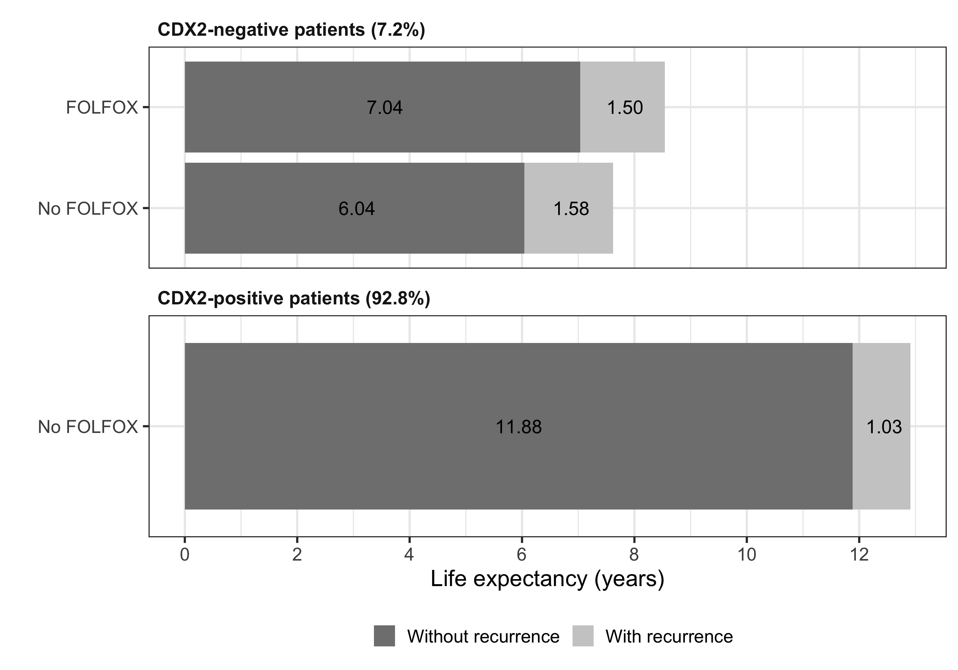
Health Impact
Chemotherapy
No chemotherapy
No chemotherapy

Slide 42
Cost-Effectiveness Results
Strategy | Costs | QALYs | ICER
No testing and no adjuvant treatment | $ 89,797 | 6.838 | -
Test all & treat CDX2-negative patients | $ 89,991 | 6.874 | $ 5,469

Slide 43
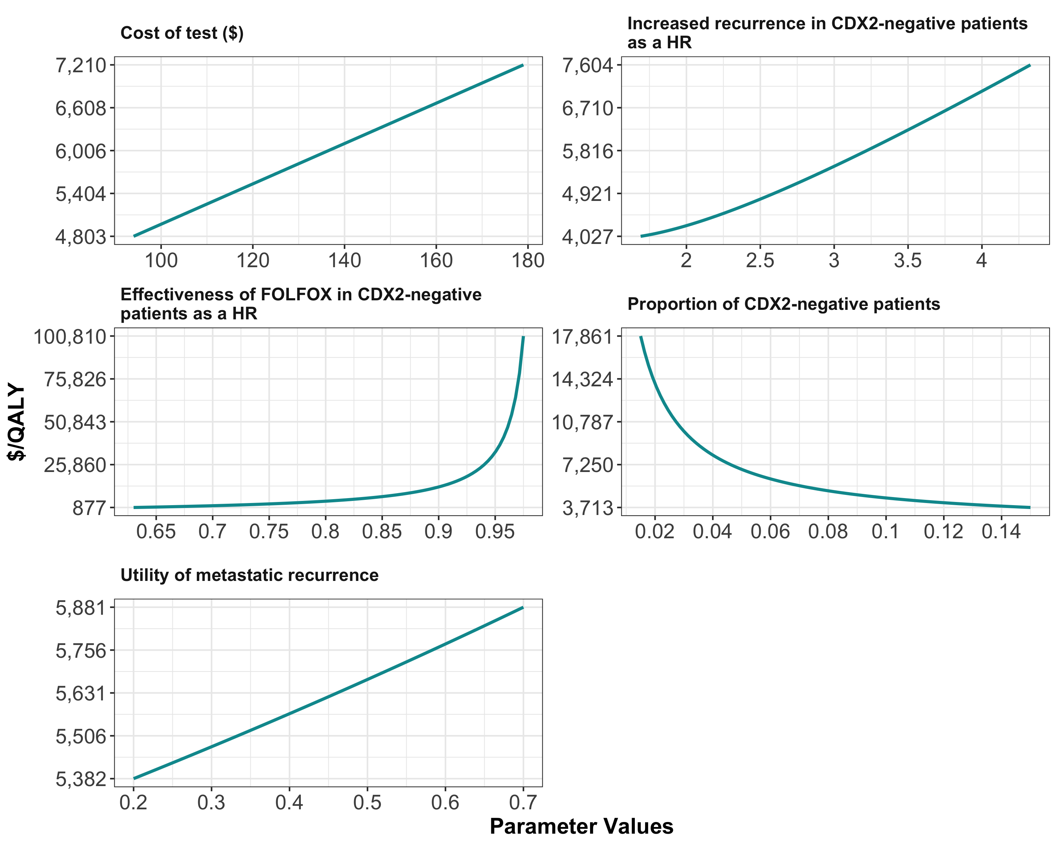
One-way Sensitivity Analysis
Chemotherapy effectiveness in CDX2-negative patients as a HR

Slide 44
Choosing your model type
Notes:
Part 1 = Showing code 3 state model
Part 2 = Exercise build Sick-Sicker model
Part 3 = Show answers of Sick-Sicker

Slide 45
Decision Trees
Advantages:
Simple
Intuitive, clear visual representation
Best for decisions made over a short time horizon
Clinical decisions (test, treat, etc.) for acute illness
Lifetime consequences can be quantified by using (pre-computed) life-expectancy as terminal value
Not as appropriate in applications where there are repeated decisions or events
Can be used to represent upfront strategy decisions, followed by a dynamic model for longer-term outcomes

Slide 46
Cohort State-Transition Models
Advantages:
Represents dynamic processes
Still relatively simple
Computationally efficient
Best for dynamic processes that
Can be represented with a reasonable number of states
Don’t dependent too much on individual heterogeneity (e.g., homogeneous cohort is a good approximation)
Minimal dependence on clinical history or time-in-state
Usually deterministic (generate mean outcomes), but can be simulated stochastically

Slide 47
Quick Note: Compartmental Models
Dynamic models similar to state-transition models, with key differences:
Open population (not a cohort)
Transition probabilities or rates can depend on population state → infectious processes
e.g., risk of infection depends on prevalence of infection in the population

Slide 48
Stochastic Individual-Based Models
Includes: microsimulation models, agent-based models
Advantages:
Represents stochastic dynamic processes
Most flexible model type
Can capture complex dependencies on individual features, clinical history, time-since-event
Can capture interactions (agent-based model, network model)
Best when a state-transition model is not sufficient
Disadvantages
Computationally intensive
Data intensive

Slide 50
A Cost-Effectiveness Analysis Example
Notes:
Part 1 = Showing code 3 state model
Part 2 = Exercise build Sick-Sicker model
Part 3 = Show answers of Sick-Sicker

Slide 51
Herceptin® (trastuzumab) for Metastatic Breast Cancer
Given in combination with chemotherapy
Only benefits patients whose tumors overexpress HER2/neu protein (20-30% of patients) and costs ~$4500/3 week cycle
There are a number of different tests to identify HER2 overexpressers
What’s the optimal testing strategy?
Elkin EB et al. Journal of Clinical Oncology 2004

Slide 52
Available Tests
Immunohistochemical assays (IHCs) for protein overexpression (HercepTest)
Less accurate, less costly
Fluorescence in situ hybridization (FISH) for gene amplification
Accepted gold standard, 3x more costly than HercepTest

Slide 53
Five Strategies Evaluated
1. No HercepTest, no Herceptin
2. HercepTest, Herceptin to 3+
3. HercepTest, Herceptin to 3+, FISH 2+
4. HercepTest, Herceptin to 2+ or 3+
5. FISH, Herceptin for positive results

Slide 54
Herceptin is effective in patients who overexpress HER-2
Herceptin increases response rate (50% vs. 32%)
Herceptin extends median duration of response (9.1 months vs. 6.1 months)
Herceptin improves one-year survival (73% vs. 61%)

Slide 55
Herceptin is not effective in patients who are FISH negative
Response Rate by FISH Result
FISH+ FISH−
(n=241) (n=95)
C alone 27% 39%
C + Herceptin 54% 41%

Slide 56
Results: Costs and Effects
Strategy QALYs Cost
No test, chemo 1.29 $53,413
HT, treat 3+ 1.36 $65,867
HT, treat 3+, FISH 2+ 1.37 $74,100
HT, treat 2+ & 3+ 1.37 $68,461
FISH, treat + 1.38 $68,150
Simple Dominance

Slide 57
Results
Strategy QALYs Cost ICER*
No test, chemo 1.29 $53,413 -
HT, treat 3 1.36 $65,867 $178K/QALY
FISH, treat + 1.38 $68,150 $114K/QALY
*ICER = ΔCost/ΔQALY compared with next best strategy

Slide 58
Results
Strategy QALYs Cost ICER*
No test, chemo 1.29 $53,413 -
HT, treat 3 1.36 $65,867 $178K/QALY
FISH, treat + 1.38 $68,150
$161K/QALY
Weak Dominance

Slide 59
Net Monetary Benefit (NMB) (WTP threshold)
Strategy NMB ($) ($100K/QALY) ($200K/QALY)
No test, chemo 75,587 204,587
HT, treat 3+ 70,133 206,133
HT, treat 3+, FISH 2+ 62,900 199,900
HT, treat 2+ & 3+ 68,539 205,539
FISH, treat + 69,850 207,850
NMB = QALYs*WTP - Cost

Slide 60
Graphical Representations of CEA Output

Slide 61
Modeling for USPSTF
Many different colorectal cancer screening strategies
Age to begin screening
Age to end screening
Screening interval
Screening modality
Costs NOT allowed!!
Life years gained and colonoscopies required

Slide 62
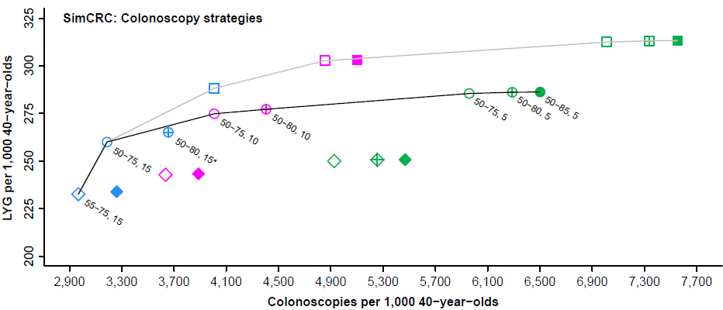
USPSTF Recommendations for 2016 Decision Analysis for Colonoscopy
Interval (color)
Age to begin-age to end screening (symbol)
Efficient frontier
15
45-75y
45-80y
45-85y
With age to begin 45, 50 or 55
10
50-75y
50-80y
50-85y
With age to begin 50 or 55
5
55-75y
55-80y
55-85y
Labeled strategies are efficient or near-efficient with age to begin 50 or 55. * indicates strategy is near-efficient (LYG within 98% of the efficient frontier).
Knudsen AB, et al.; JAMA, Vol. 315 No. 23, June 21, 2016

Slide 63
CEA of Lumacaftor-Ivacaftor for Cystic Fibrosis

Slide 64
Probabilistic Sensitivity Analysis
Inputs
Model
Outputs
x
1
Effect
x
NMB
2
Cost
x
i

Slide 65
Luma-Iva vs. Best Supportive Care for CF

Slide 66
Example with More Uncertainty
Δ Cost
Δ Effectiveness

Slide 67
CE Acceptability Curve

Slide 68
Decision Tree Example in R
Exercise described in “DecisionTree_HVE_Exercise.docx”
Evaluate the cost-effectiveness of the three viral encephalitis strategies:
No biopsy and no treatment
No biopsy and treat all
Brain biopsy and only treat if positive
Some changes from the example:
Health outcome will be quality-adjusted life years (QALYs)
Costs will be added as a second outcome (to conduct a cost-effectiveness analysis)

Slide 69
HVE
0.52
Treat
0.48
OVE
no complications
HVE
0.29
0.52
0.71
complications
Do not treat
no complications
0.48
OVE
0.99
0.01
complications
HVE
0.52
Costs?
No event
QALYs?
Biopsy
0.95
0.48
OVE
0.05
Biopsy event

Slide 70
R Session
Notes:
Part 1 = Showing code 3 state model
Part 2 = Exercise build Sick-Sicker model
Part 3 = Show answers of Sick-Sicker

